Slide 1
Class 6 – Monitors and Message Passing
Osama Hosam Eldeen
Taiba University

Slide 2
But first …
Continuation of Class 5 – Classical Synchronization Problems

Slide 3
Producer consumer problem
Also known as the bounded buffer problem
InP
Producer
Producer and consumer
are separate threads
8 Buffers
OutP
Consumer

Slide 4
Does this solution work?
Global variables
semaphore full_buffs = 0;
semaphore empty_buffs = n;
char buff[n];
int InP, OutP;
0 thread producer {
while(1){
// Produce char c...
down(empty_buffs)
buf[InP] = c
InP = InP + 1 mod n
up(full_buffs)
7 }
8 }
0 thread consumer {
while(1){
down(full_buffs)
c = buf[OutP]
OutP = OutP + 1 mod n
up(empty_buffs)
// Consume char...
}
8 }

Slide 5
Producer consumer problem
What is the shared state in the last solution?
Does it apply mutual exclusion? If so, how?
InP
Producer
Producer and consumer
are separate threads
8 Buffers
OutP
Consumer

Slide 6
Problems with solution
What if we have multiple producers and multiple consumers?
  Producer-specific and consumer-specific data becomes shared
  We need to define and protect critical sections

Slide 7

Dining philosophers problem
Five philosophers sit at a table
One fork/chopstick between each
philosopher – need two to eat
Why do they need to synchronize?
How should they do it?
Each philosopher is
modeled with a thread
while(TRUE) {
Think();
Grab first fork;
Grab second fork;
Eat();
Put down first fork;
Put down second fork;
}

Slide 8
Is this a valid solution?
#define N 5
Philosopher() {
while(TRUE) {
Think();
take_fork(i);
take_fork((i+1)% N);
Eat();
put_fork(i);
put_fork((i+1)% N);
}
}

Slide 9
Problems
Holding one fork while you wait for the other can lead to deadlock!
  You should not hold on to a fork unless you can get both
  Is there a deterministic, deadlock-free, starvation-free solution to doing this?

Slide 10
Working towards a solution …
take_forks(i)
#define N 5
Philosopher() {
while(TRUE) {
Think();
take_fork(i);
take_fork((i+1)% N);
Eat();
put_fork(i);
put_fork((i+1)% N);
}
}
put_forks(i)

Slide 11
Working towards a solution …
#define N 5
Philosopher() {
while(TRUE) {
Think();
take_forks(i);
Eat();
put_forks(i);
}
}

Slide 12
Picking up forks
int state[N]
semaphore mutex = 1
semaphore sem[i]
// only called with mutex set!
test(int i) {
if (state[i] == HUNGRY &&
state[LEFT] != EATING &&
state[RIGHT] != EATING){
state[i] = EATING;
signal(sem[i]);
}
}
take_forks(int i) {
wait(mutex);
state [i] = HUNGRY;
test(i);
signal(mutex);
wait(sem[i]);
}

Slide 13
Putting down forks
int state[N]
semaphore mutex = 1
semaphore sem[i]
// only called with mutex set!
test(int i) {
if (state[i] == HUNGRY &&
state[LEFT] != EATING &&
state[RIGHT] != EATING){
state[i] = EATING;
signal(sem[i]);
}
}
put_forks(int i) {
wait(mutex);
state [i] = THINKING;
test(LEFT);
test(RIGHT);
signal(mutex);
}

Slide 14
Dining philosophers
Is the previous solution correct?
What does it mean for it to be correct?
How could you generate output to help detect common problems?
  What would a race condition look like?
  What would deadlock look like?
  What would starvation look like?

Slide 15
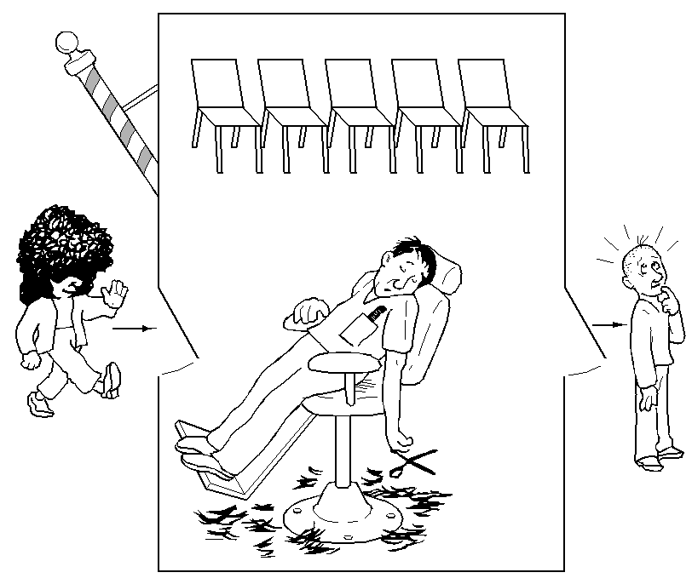
The sleeping barber problem

Slide 16
The sleeping barber problem
Barber:
  While there are customers waiting for a hair cut put one in the barber chair and cut their hair
  When done move to the next customer else go to sleep, until a customer comes in
Customer:
  If barber is asleep wake him up for a haircut
  If someone is getting a haircut wait for the barber to become free by sitting in a chair
  If all chairs are all full, leave the barbershop

Slide 17
Designing a solution
How will we model the barber(s) and customers?
What state variables do we need?
  .. and which ones are shared?
  …. and how will we protect them?
How will the barber sleep?
How will the barber wake up?
How will customers wait?
How will they proceed?
What problems do we need to look out for?

Slide 18
Is this a good solution?
const CHAIRS = 5
var customers: Semaphore
barbers: Semaphore
lock: Mutex
numWaiting: int = 0
Customer Thread:
Lock(lock)
if numWaiting < CHAIRS
numWaiting = numWaiting+1
Signal(customers)
Unlock(lock)
Wait(barbers)
GetHaircut()
else -- give up & go home
Unlock(lock)
endIf
Barber Thread:
while true
Wait(customers)
Lock(lock)
numWaiting = numWaiting-1
Signal(barbers)
Unlock(lock)
CutHair()
endWhile

Slide 19
The readers and writers problem
Multiple readers and writers want to access a database (each one is a thread)
Multiple readers can proceed concurrently
  No race condition if nobody is modifying data
Writers must synchronize with readers and other writers
  only one writer at a time !
  when someone is writing, there must be no readers !
Goals:
  Maximize concurrency.
  Prevent starvation.

Slide 20
Designing a solution
How will we model the readers and writers?
What state variables do we need?
  .. and which ones are shared?
  …. and how will we protect them?
How will the writers wait?
How will the writers wake up?
How will readers wait?
How will the readers wake up?
What problems do we need to look out for?

Slide 21
Is this a valid solution to readers & writers?
var mut: Mutex = unlocked
db: Semaphore = 1
rc: int = 0
Reader Thread:
while true
Lock(mut)
rc = rc + 1
if rc == 1
Wait(db)
endIf
Unlock(mut)
... Read shared data...
Lock(mut)
rc = rc - 1
if rc == 0
Signal(db)
endIf
Unlock(mut)
... Remainder Section...
endWhile
Writer Thread:
while true
...Remainder Section...
Wait(db)
...Write shared data...
Signal(db)
endWhile

Slide 22
Readers and writers solution
Does the previous solution have any problems?
  is it “fair”?
  can any threads be starved? If so, how could this be fixed?

Slide 23
Monitors

Slide 24
Monitors
It is difficult to produce correct programs using semaphores
  correct ordering of wait and signal is tricky!
  avoiding race conditions and deadlock is tricky!
  boundary conditions are tricky!
Can we get the compiler to generate the correct semaphore code for us?
  what are suitable higher level abstractions for synchronization?

Slide 25
Monitors
Related shared objects are collected together
Compiler enforces encapsulation/mutual exclusion
  Encapsulation:
    Local data variables are accessible only via the monitor’s entry procedures (like methods)
  Mutual exclusion
    A monitor has an associated mutex lock
    Threads must acquire the monitor’s mutex lock before invoking one of its procedures

Slide 26
Monitors and condition variables
But we need two flavors of synchronization
  Mutual exclusion
    Only one at a time in the critical section
    Handled by the monitor’s mutex
  Condition synchronization
    Wait until a certain condition holds
    Signal waiting threads when the condition holds

Slide 27
Monitors and condition variables
Condition variables (cv) for use within monitors
  cv.wait(mon-mutex)
    thread blocked (queued) until condition holds
    Must not block while holding mutex!
    monitor mutex must be released!
  cv.signal()
    signals the condition and unblocks (dequeues) a thread

Slide 28
Monitor structures
shared data
monitor entry queue
condition variables
x
y
Local to monitor
(Each has an associated
list of waiting threads)
List of threads
waiting to
enter the monitor
“entry” methods
Can be called from
outside the monitor.
Only one active at
any moment.
local methods
initialization
code

Slide 29
Monitor example for mutual exclusion
process Producer
begin
loop
<produce char “c”>
BoundedBuffer.deposit(c)
end loop
end Producer_x0003_
monitor: BoundedBuffer
var buffer : ...;
nextIn, nextOut :... ;
entry deposit(c: char)
begin
...
end
entry remove(var c: char)
begin
...
end
end BoundedBuffer
process Consumer
begin
loop
BoundedBuffer.remove(c)
<consume char “c”>
end loop
end Consumer

Slide 30
Observations
That’s much simpler than the semaphore-based solution to producer/consumer (bounded buffer)!
… but where is the mutex?
… and what do the bodies of the monitor procedures look like?

Slide 31
Monitor example with condition variables
monitor : BoundedBuffer
var buffer : array[0..n-1] of char
nextIn,nextOut : 0..n-1 := 0
fullCount : 0..n := 0
notEmpty, notFull : condition
entry deposit(c:char) entry remove(var c: char)
begin begin
if (fullCount = n) then if (fullCount = n) then
wait(notFull) wait(notEmpty)
end if end if
buffer[nextIn] := c c := buffer[nextOut]
nextIn := nextIn+1 mod n nextOut := nextOut+1 mod n
fullCount := fullCount+1 fullCount := fullCount-1
signal(notEmpty) signal(notFull)
end deposit end remove
end BoundedBuffer

Slide 32
Condition variables
“Condition variables allow processes to synchronize based on some state of the monitor variables.”

Slide 33
Condition variables in producer/consumer
“NotFull” condition
“NotEmpty” condition
Operations Wait() and Signal() allow synchronization within the monitor
When a producer thread adds an element...
  A consumer may be sleeping
  Need to wake the consumer... Signal

Slide 34
Condition synchronization semantics
“Only one thread can be executing in the monitor at any one time.”
Scenario:
  Thread A is executing in the monitor
  Thread A does a signal waking up thread B
  What happens now?
  Signaling and signaled threads can not both run!
  … so which one runs, which one blocks, and on what queue?

Slide 35
Monitor design choices
Condition variables introduce a problem for mutual exclusion
  only one process active in the monitor at a time, so what to do when a process is unblocked on signal?
  must not block holding the mutex, so what to do when a process blocks on wait?

Slide 36
Monitor design choices
Choices when A signals a condition that unblocks B
  A waits for B to exit the monitor or block again
  B waits for A to exit the monitor or block
  Signal causes A to immediately exit the monitor or block (… but awaiting what condition?)
Choices when A signals a condition that unblocks B & C
  B is unblocked, but C remains blocked
  C is unblocked, but B remains blocked
  Both B & C are unblocked … and compete for the mutex?
Choices when A calls wait and blocks
  a new external process is allowed to enter
  but which one?

Slide 37
Option 1: Hoare semantics
What happens when a Signal is performed?
  signaling thread (A) is suspended
  signaled thread (B) wakes up and runs immediately
Result:
  B can assume the condition is now true/satisfied
  Hoare semantics give strong guarantees
  Easier to prove correctness
When B leaves monitor, A can run.
    A might resume execution immediately
    ... or maybe another thread (C) will slip in!

Slide 38
Option 2: MESA Semantics (Xerox PARC)
What happens when a Signal is performed?
  the signaling thread (A) continues.
  the signaled thread (B) waits.
  when A leaves monitor, then B runs.
Issue: What happens while B is waiting?
  can the condition that caused A to generate the signal be changed before B runs?
In MESA semantics a signal is more like a hint
  Requires B to recheck the condition on which it waited to see if it can proceed or must wait some more

Slide 39
Code for the “deposit” entry routine
monitor BoundedBuffer
var buffer: array[n] of char
nextIn, nextOut: int = 0
cntFull: int = 0
notEmpty: Condition
notFull: Condition
entry deposit(c: char)
if cntFull == N
notFull.Wait()
endIf
buffer[nextIn] = c
nextIn = (nextIn+1) mod N
cntFull = cntFull + 1
notEmpty.Signal()
endEntry
entry remove()
...
endMonitor
Hoare Semantics

Slide 40
Code for the “deposit” entry routine
monitor BoundedBuffer
var buffer: array[n] of char
nextIn, nextOut: int = 0
cntFull: int = 0
notEmpty: Condition
notFull: Condition
entry deposit(c: char)
while cntFull == N
notFull.Wait()
endWhile
buffer[nextIn] = c
nextIn = (nextIn+1) mod N
cntFull = cntFull + 1
notEmpty.Signal()
endEntry
entry remove()
...
endMonitor
MESA Semantics

Slide 41
Code for the “remove” entry routine
monitor BoundedBuffer
var buffer: array[n] of char
nextIn, nextOut: int = 0
cntFull: int = 0
notEmpty: Condition
notFull: Condition
entry deposit(c: char)
...
entry remove()
if cntFull == 0
notEmpty.Wait()
endIf
c = buffer[nextOut]
nextOut = (nextOut+1) mod N
cntFull = cntFull - 1
notFull.Signal()
endEntry
endMonitor
Hoare Semantics

Slide 42
Code for the “remove” entry routine
monitor BoundedBuffer
var buffer: array[n] of char
nextIn, nextOut: int = 0
cntFull: int = 0
notEmpty: Condition
notFull: Condition
entry deposit(c: char)
...
entry remove()
while cntFull == 0
notEmpty.Wait()
endWhile
c = buffer[nextOut]
nextOut = (nextOut+1) mod N
cntFull = cntFull - 1
notFull.Signal()
endEntry
endMonitor
MESA Semantics

Slide 43
“Hoare Semantics”
What happens when a Signal is performed?
The signaling thread (A) is suspended.
The signaled thread (B) wakes up and runs immediately.
B can assume the condition is now true/satisfied
From the original Hoare Paper:
“No other thread can intervene [and enter the monitor] between the signal and the continuation of exactly one waiting thread.”
“If more than one thread is waiting on a condition, we postulate that the signal operation will reactivate the longest waiting thread. This gives a simple neutral queuing discipline which ensures that every waiting thread will eventually get its turn.”

Slide 44
Implementing Hoare Semantics
Thread A holds the monitor lock
Thread A signals a condition that thread B was waiting on
Thread B is moved back to the ready queue?
  B should run immediately
  Thread A must be suspended...
  the monitor lock must be passed from A to B
When B finishes it releases the monitor lock
Thread A must re-acquire the lock
  A is blocked, waiting to re-aquire the lock

Slide 45
Implementing Hoare Semantics
Problem:
  Possession of the monitor lock must be passed directly from A to B and then eventually back to A

Slide 46
Implementing Hoare Semantics
Implementation Ideas:
  Consider a signaled thread like B to be “urgent” after A releases the monitor lock
    Thread C trying to gain initial entry to the monitor is not “urgent”
  Consider two wait lists associated with each MonitorLock (so now this is not exactly a mutex)
    UrgentlyWaitingThreads
    NonurgentlyWaitingThreads
  Want to wake up urgent threads first, if any
  Alternatively, B could be added to the front of the monitor lock queue

Slide 47
Implementing Hoare Semantics
Recommendation for Project 4 implementation:
  Do not modify the mutex methods provided, because future code will use them
  Create new classes:
    MonitorLock -- similar to Mutex
    HoareCondition -- similar to Condition

Slide 48
Brinch-Hansen Semantics
Hoare Semantics
  On signal, allow signaled process to run
  Upon its exit from the monitor, signaling process continues.
Brinch-Hansen Semantics
  Signaler must immediately exit following any invocation of signal
  Restricts the kind of solutions that can be written
  … but monitor implementation is easier

Slide 49
Review of a Practical Concurrent
Programming Issue – Reentrant Functions

Slide 50
Reentrant code
A function/method is said to be reentrant if...
  A function that has been invoked may be invoked again before the first invocation has returned, and will still work correctly
In the context of concurrent programming...
  A reentrant function can be executed simultaneously by more than one thread, with no ill effects

Slide 51
Reentrant Code
Consider this function...
var count: int = 0
function GetUnique () returns int
count = count + 1
return count
endFunction
What if it is executed by different threads concurrently?

Slide 52
Reentrant Code
Consider this function...
var count: int = 0
function GetUnique () returns int
count = count + 1
return count
endFunction
What if it is executed by different threads concurrently?
  The results may be incorrect!
  This routine is not reentrant!

Slide 53
When is code reentrant?
Some variables are
  “local” -- to the function/method/routine
  “global” -- sometimes called “static”
Access to local variables?
  A new stack frame is created for each invocation
  Each thread has its own stack
What about access to global variables?
  Must use synchronization!

Slide 54
Does this work?
var count: int = 0
myLock: Mutex
function GetUnique () returns int
myLock.Lock()
count = count + 1
myLock.Unlock()
return count
endFunction

Slide 55
What about this?
var count: int = 0
myLock: Mutex
function GetUnique () returns int
myLock.Lock()
count = count + 1
return count
myLock.Unlock()
endFunction

Slide 56
Making this function reentrant
var count: int = 0
myLock: Mutex
function GetUnique () returns int
var i: int
myLock.Lock()
count = count + 1
i = count
myLock.Unlock()
return i
endFunction

Slide 57
Message Passing

Slide 58
Message Passing
Interprocess Communication
  via shared memory
  across machine boundaries
Message passing can be used for synchronization or general communication
Processes use send and receive primitives
  receive can block (like waiting on a Semaphore)
  send unblocks a process blocked on receive (just as a signal unblocks a waiting process)

Slide 59
Producer-consumer with message passing
The basic idea:
  After producing, the producer sends the data to consumer in a message
  The system buffers messages
    The producer can out-run the consumer
    The messages will be kept in order
  But how does the producer avoid overflowing the buffer?
    After consuming the data, the consumer sends back an “empty” message
  A fixed number of messages (N=100)
  The messages circulate back and forth.

Slide 60
Producer-consumer with message passing
const N = 100 -- Size of message buffer
var em: char
for i = 1 to N -- Get things started by
Send (producer, &em) -- sending N empty messages
endFor
thread consumer
var c, em: char
while true
Receive(producer, &c) -- Wait for a char
Send(producer, &em) -- Send empty message back
// Consume char...
endWhile
end

Slide 61
Producer-consumer with message passing
thread producer
var c, em: char
while true
// Produce char c...
Receive(consumer, &em) -- Wait for an empty msg
Send(consumer, &c) -- Send c to consumer
endWhile
end

Slide 62
Design choices for message passing
Option 1: Mailboxes
  System maintains a buffer of sent, but not yet received, messages
  Must specify the size of the mailbox ahead of time
  Sender will be blocked if the buffer is full
  Receiver will be blocked if the buffer is empty

Slide 63
Design choices for message passing
Option 2: No buffering
  If Send happens first, the sending thread blocks
  If Receiver happens first, the receiving thread blocks
  Sender and receiver must Rendezvous (ie. meet)
  Both threads are ready for the transfer
  The data is copied / transmitted
  Both threads are then allowed to proceed

Slide 64
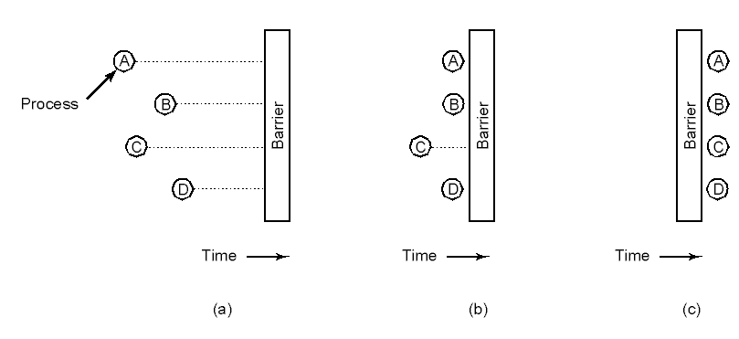
Barriers
  Processes approaching a barrier
  All processes but one blocked at barrier
  Last process arrives; all are let through

Slide 65
Quiz
What is the difference between a monitor and a semaphore?
  Why might you prefer one over the other?
How do the wait/signal methods of a condition variable differ from the wait/signal methods of a semaphore?
What is the difference between Hoare and Mesa semantics for condition variables?
  What implications does this difference have for code surrounding a wait() call?

